Slide 1
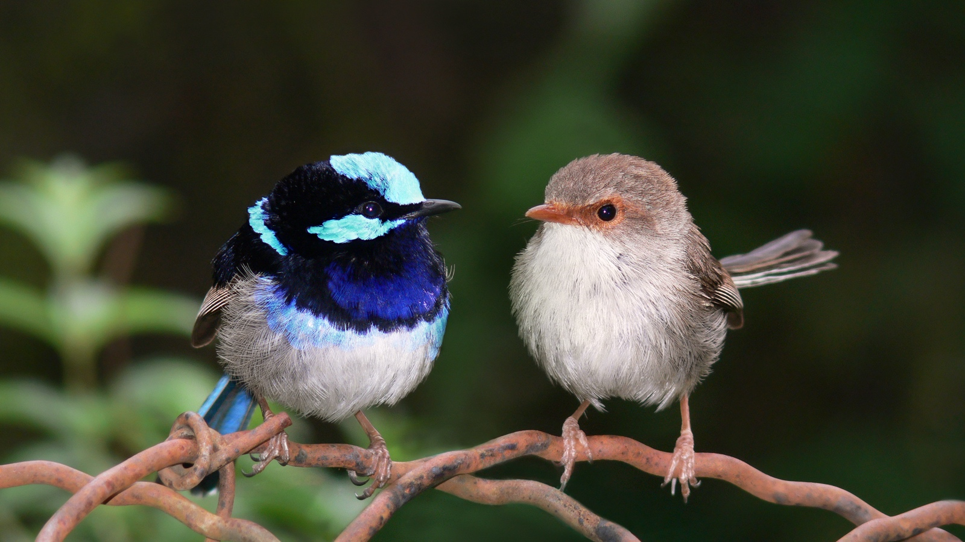
Evolution
Social Behavior & Sexual Selection

Slide 2
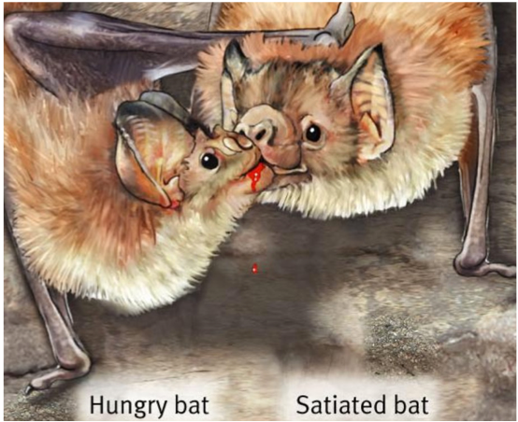
Social behavior
We know why individuals are selfish
We know why individuals engage in mutually beneficial acts
We know why individuals don’t engage in spiteful behaviors
But why do individuals behave altruistically?

Slide 3
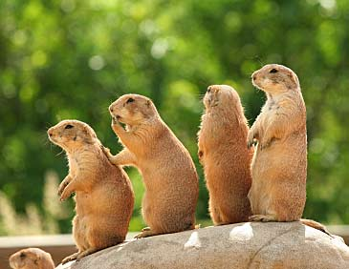
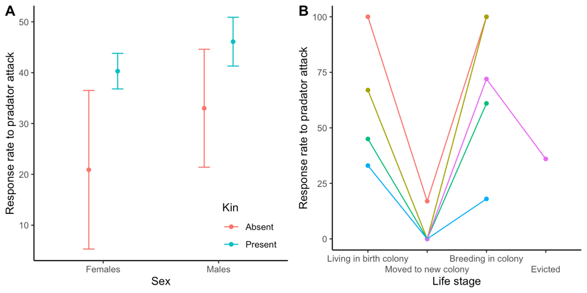
Kin selection
Alleles will spread if Br > C (Hamilton’s rule)
B is the benefit to recipient
C the cost to the actor
r is the coefficient of relatedness (probability that homologous alleles in two individuals are identical by descent)
Rationale
Inclusive fitness = direct fitness (personal reproduction) + indirect fitness (reproduction by relatives)
Simple prediction: Individuals should behave altruistically towards kin more so that towards unrelated individuals.

Slide 4
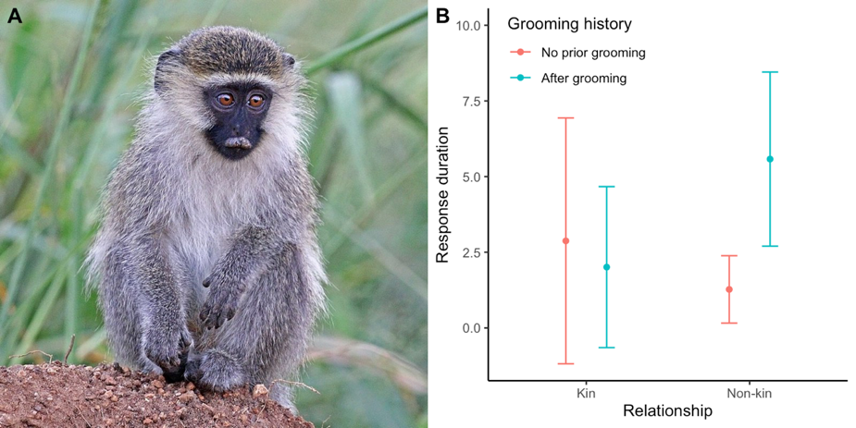
Reciprocal altruism
How do we explain altruistic behavior among non-kin?
Trivers showed that altruistic genes can spread in a population, if beneficiaries reciprocate equally later on
Cost to actor must be smaller than benefit to the recipient
Individuals that do not reciprocate must be punished
Altruism should evolve in species with
Stable groups
Many opportunities for symmetrical altruistic acts
Good memory

Slide 5
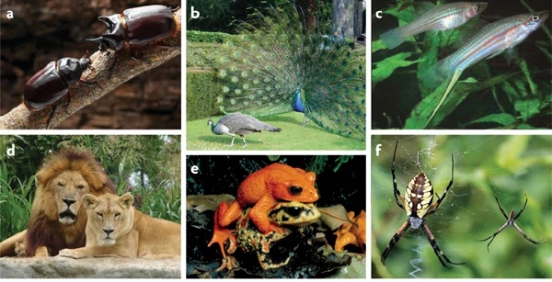

Slide 6
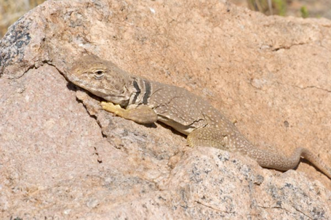
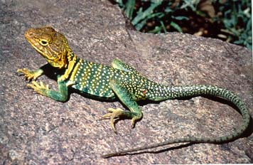
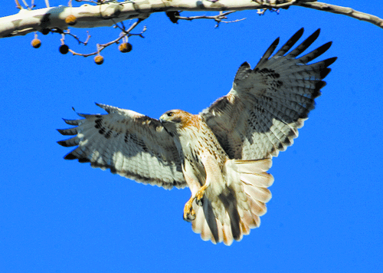
Natural selection per se cannot explain sexual dimorphism
Sexual dimorphism cannot be explained by differential survival
However, differential reproductive success is also affecting fitness
When traits increase reproductive success, they can be selected for even if they reduce survival
Sexual selection is a special form of natural selection
There can be trade-offs between survival and reproduction

Slide 7
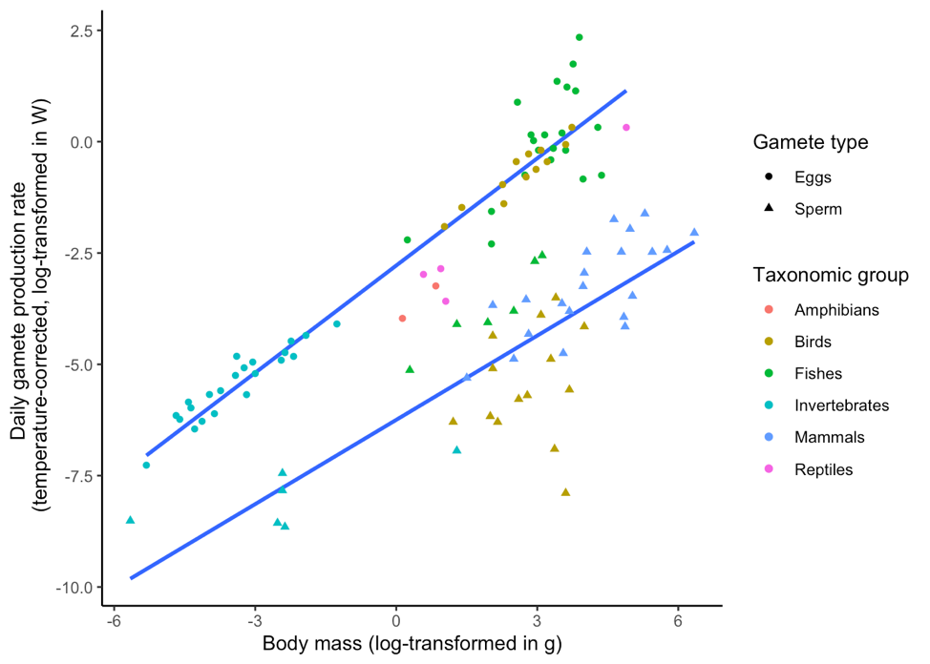
Asymmetries in sexual reproduction
If sexual selection explains sex differences, it must act differently on each sex
Basic idea: Parental investment differs between the sexes (eggs are more expensive than ejaculates; Bateman’s principle)
Reproductive success in the heavily investing sex is limited by time and energy
Low variation in fitness; weak sexual selection
Reproductive success in the lightly investing sex is limited by the number of mates
High variation in fitness; strong sexual selection

Slide 8
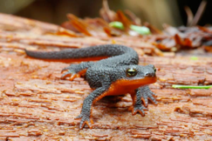
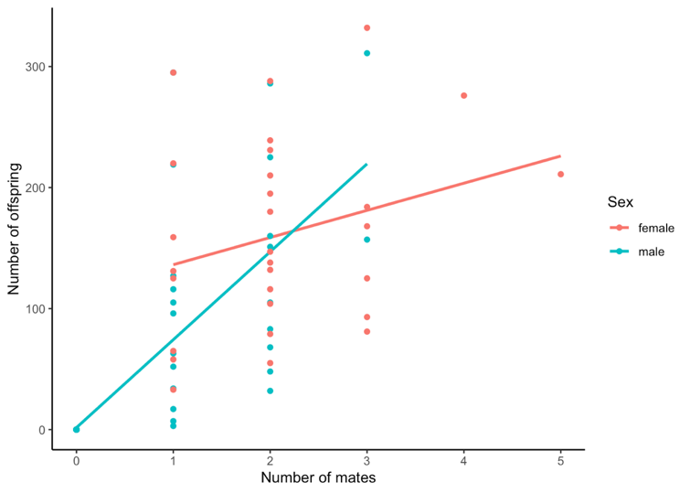
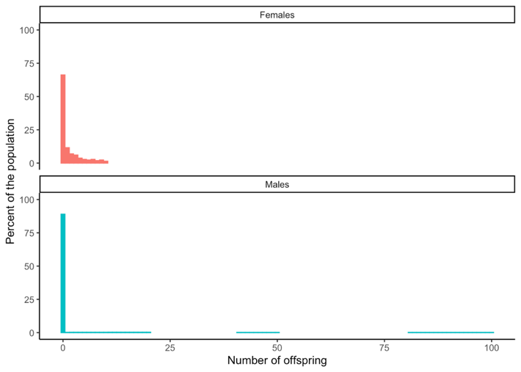
Asymmetries in sexual reproduction
If sexual selection explains sex differences, it must act differently on each sex
Basic idea: Parental investment differs between the sexes (eggs are more expensive than ejaculates; Bateman’s principle)
Reproductive success in the heavily investing sex is limited by time and energy
Low variation in fitness; weak sexual selection
Reproductive success in the lightly investing sex is limited by the number of mates
High variation in fitness; strong sexual selection

Slide 9
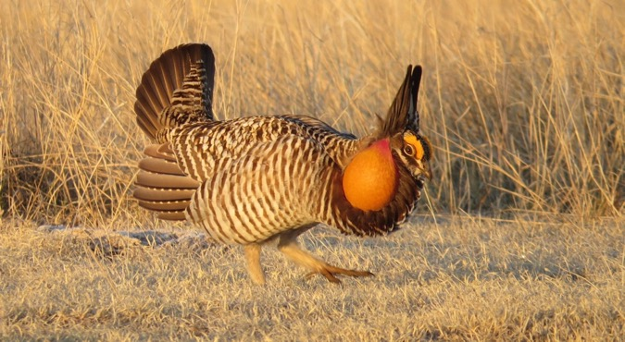
Consequences of asymmetric limits on fitness
Members of the sex subject to strong selection will be competitive!
Intrasexual selection
Sexual conflict
Members of the sex subject to weak selection will be choosy!
Intersexual selection

Slide 10
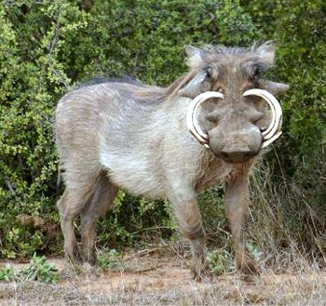
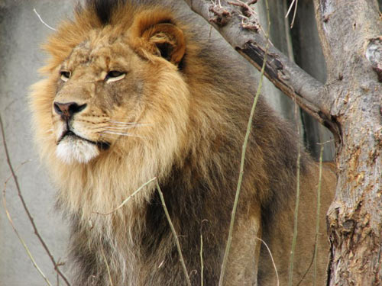
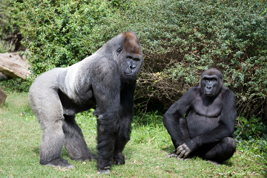
Intrasexual selection: overt combat over access to females
Large body size
Weaponry
Armor
Tactical cleverness

Slide 11
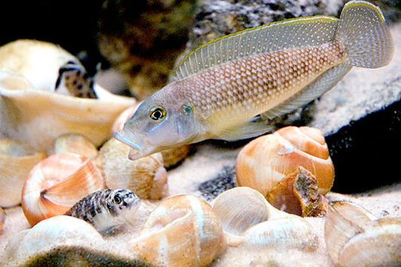
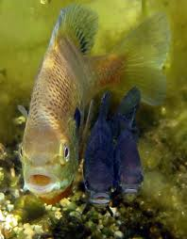
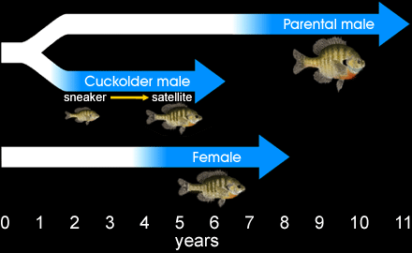
Intrasexual selection: alternative mating strategies
In many species with strong intrasexual selection, there are alternative mating strategies
Small inconspicuous males that are not perceived as threats sneak copulations with females
Usually less successful than large males, but frequency-dependent selection maintains both strategies

Slide 12
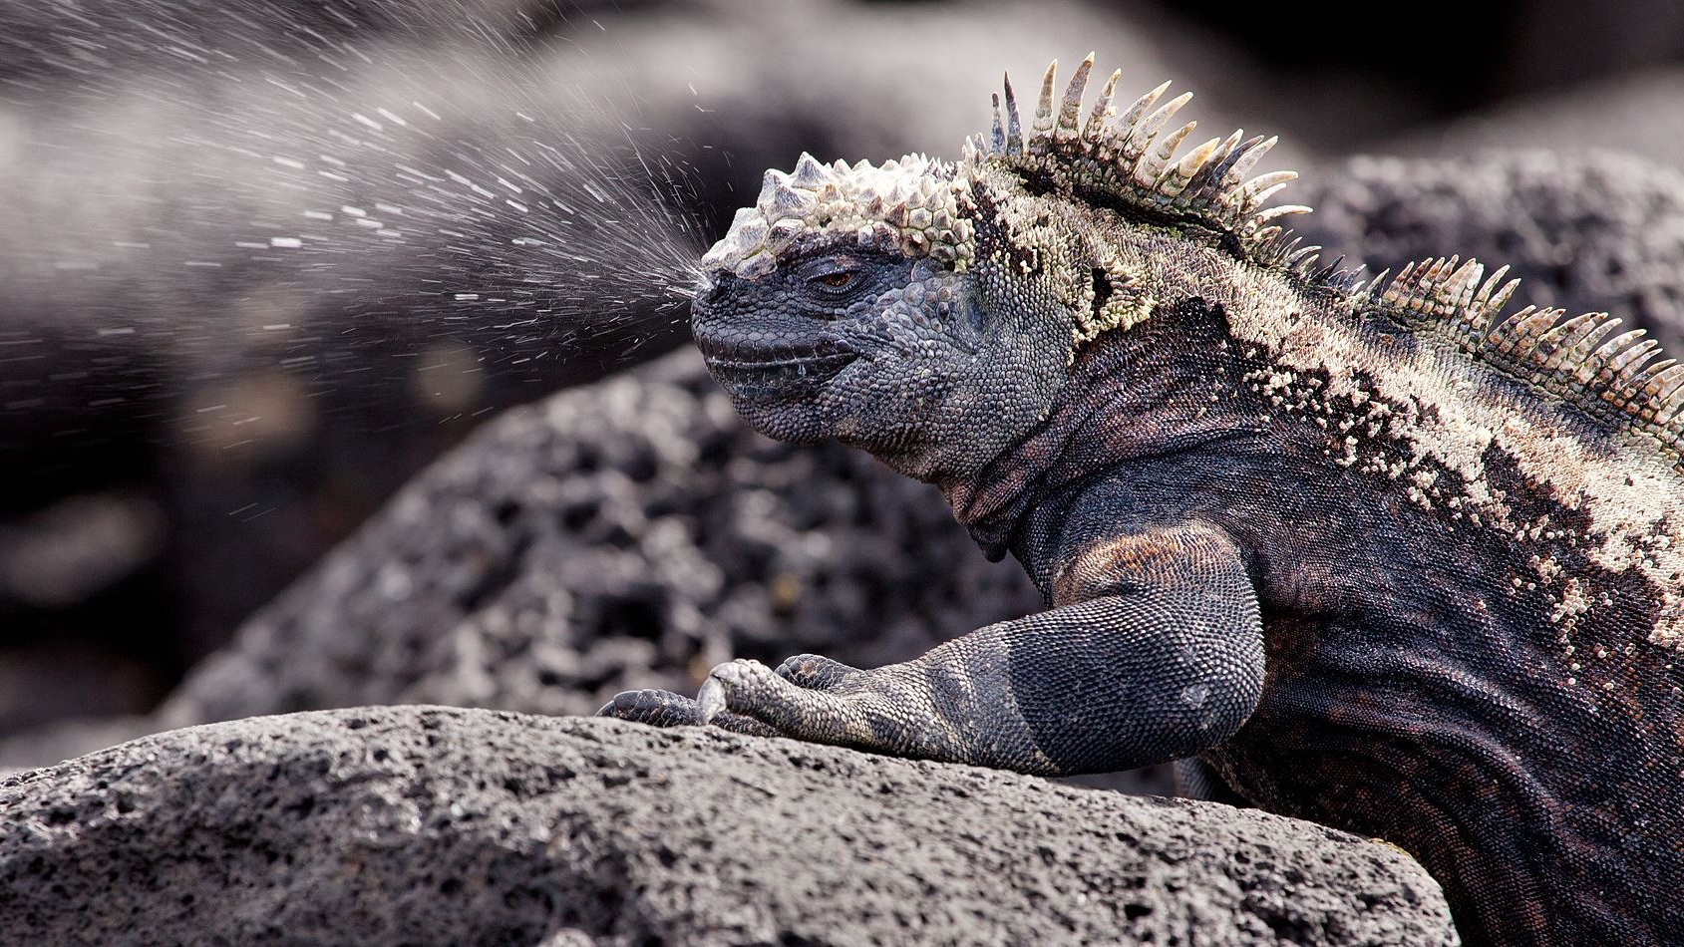
R exercise
Selection and body size variation in marine iguanas

Slide 13
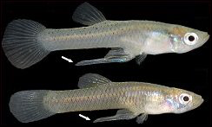
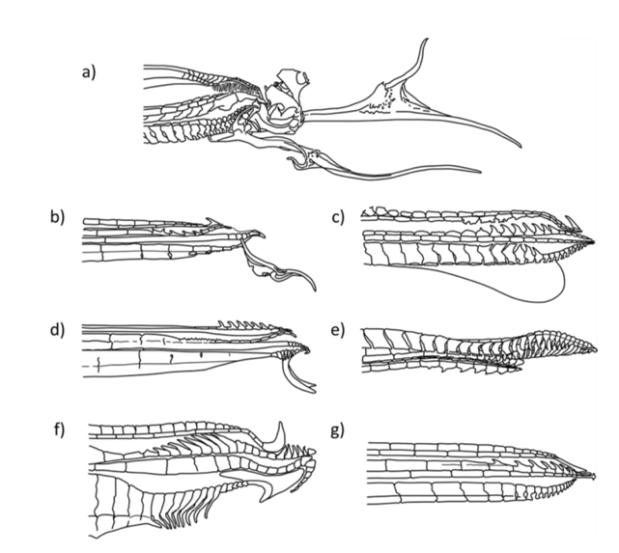
Intrasexual selection: covert combat over fertilization
Sperm competition occurs when females mate with multiple males
Males use a variety of strategies to gain the upper hand during sperm competition
Mate guarding
Prolonged copulation
Deposition of copulatory plug
Increased ejaculate size
Sperm removal mechanisms
Seminal proteins

Slide 14
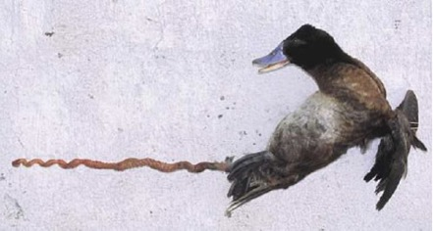
Intersexual conflict
Male adaptation to intrasexual selection can be costly to females
Males evolve traits that mediate ever higher persistence
Females evolve traits that mediate resistance to unwanted male advances
Sperm storage
Structural adaptations that minimize impact of unwanted copulations
Substances that neutralize male effects
Antagonistic co-evolution between male persistence and female resistance traits

Slide 15
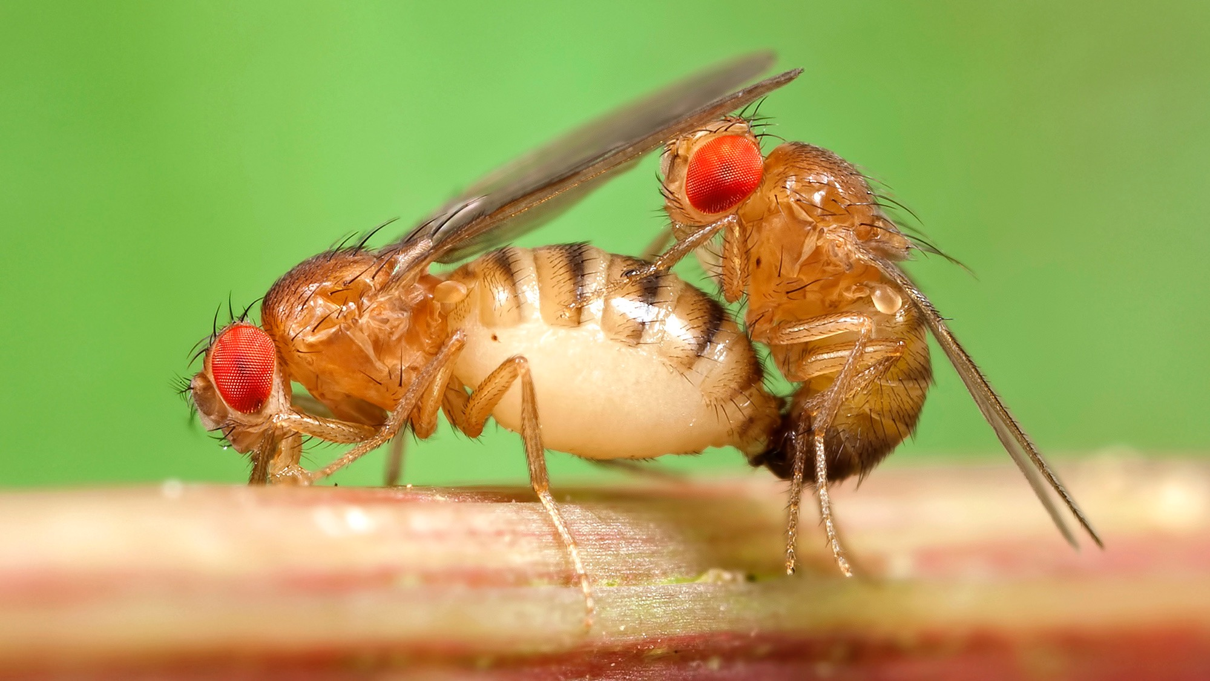
R exercise
Experimental evolution of different mating systems in Drosophila
Solve section 2 in your R Notebook

Slide 16
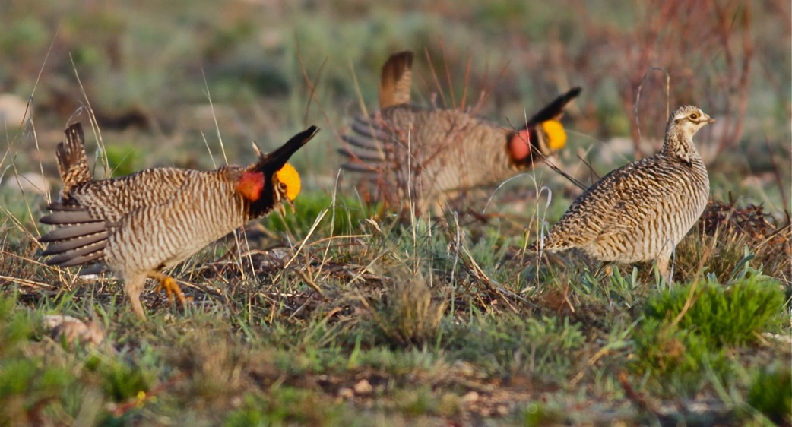
Intersexual selection: female choice
When males cannot monopolize females, they often compete by advertising for mates
In such cases, female choose with whom to mate with
Males evolve exaggerated, sexually-selected traits

Slide 17
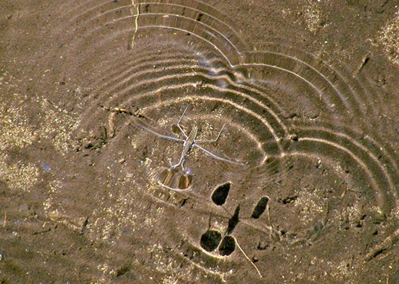
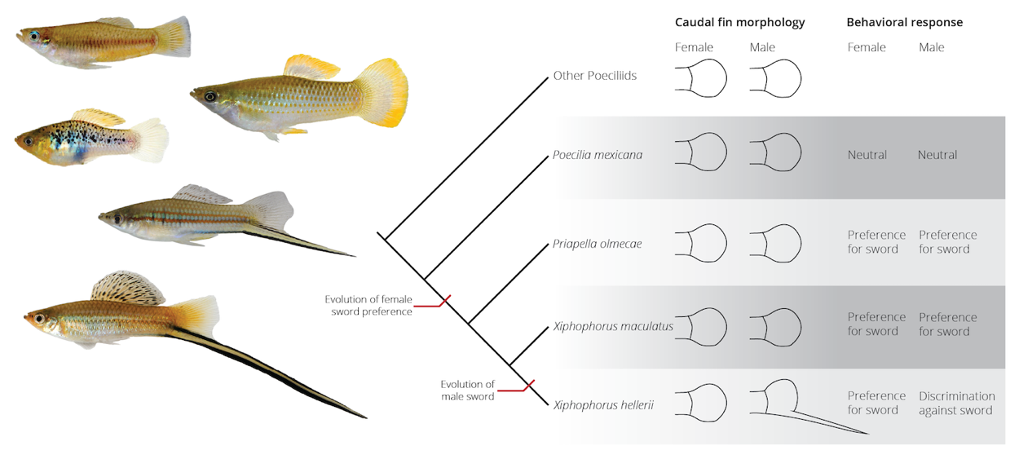
Why be choosy?
Pre-existing biases
Females’ sensory systems evolve in response to other selective pressures (foraging, predator avoidance, etc.)
Such pre-existing biases may select male displays even if they originally have no relation to mating or fitness
In this case, female preferences do not need to provide an advantage (i.e., they’re not an adaptation), but are merely a byproduct of natural selection

Slide 18
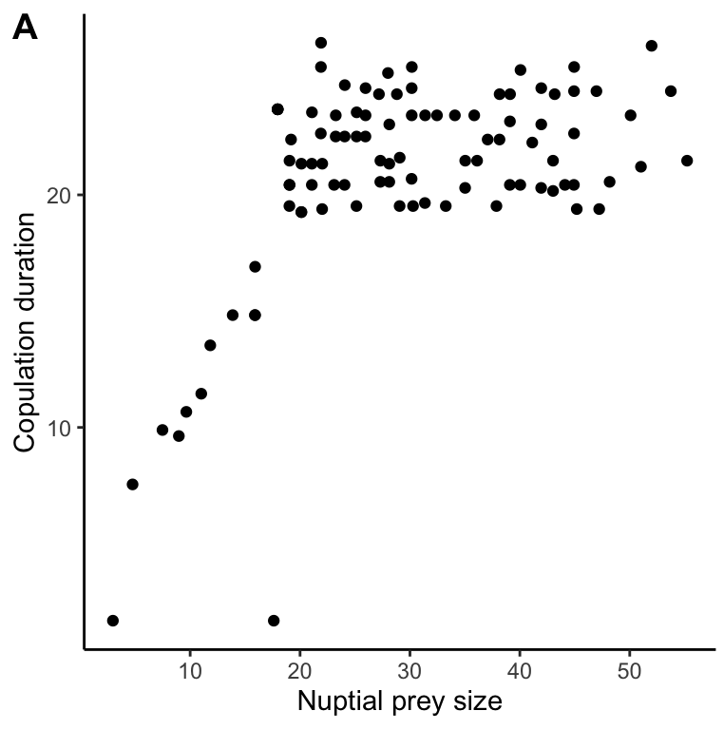
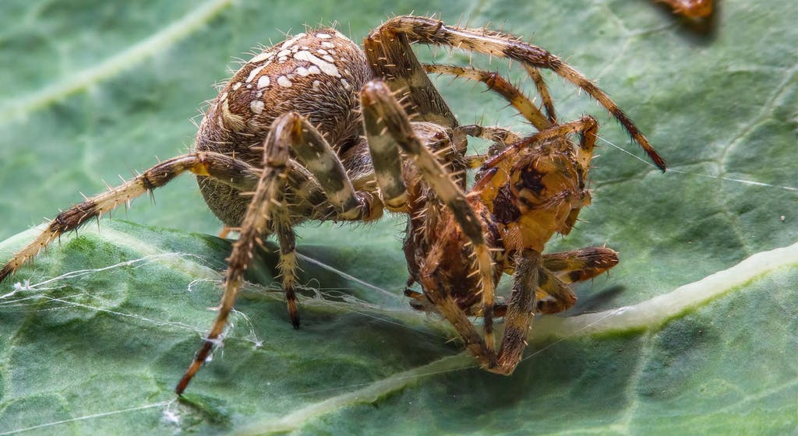
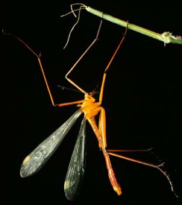
Why be choosy?
Direct fitness benefits enhance a female’s survivability or fecundity
Protection
Territories/nests
Food
Help with parental care
Reduced risk from contagious diseases

Slide 19
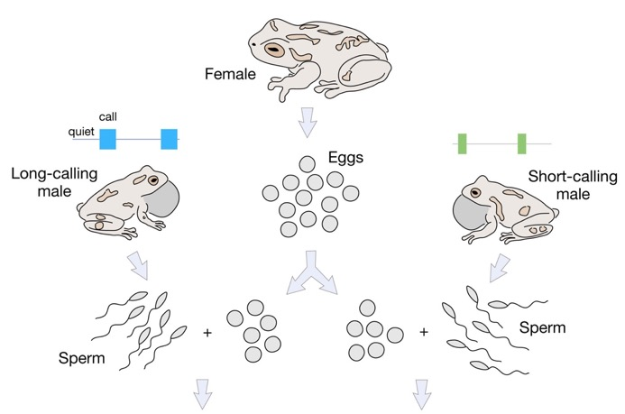
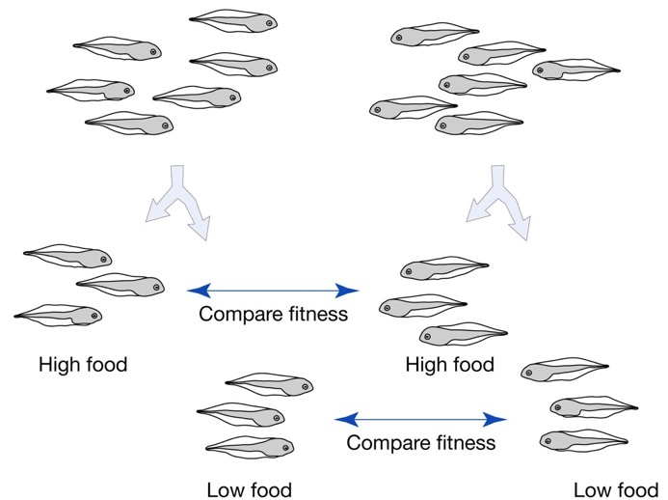
Why be choosy?
Indirect fitness benefits enhance the survivability or attractiveness of a female’s offspring
Male traits as indicators for “good genes”
Fitness measure | High food | Low food
Growth | Long calling | Long calling
Time to metamorphosis | Long calling | NS
Mass at metamorphosis | NS | NS
Survival | NS | NS
Postmet. growth | NS | Long calling

Slide 20
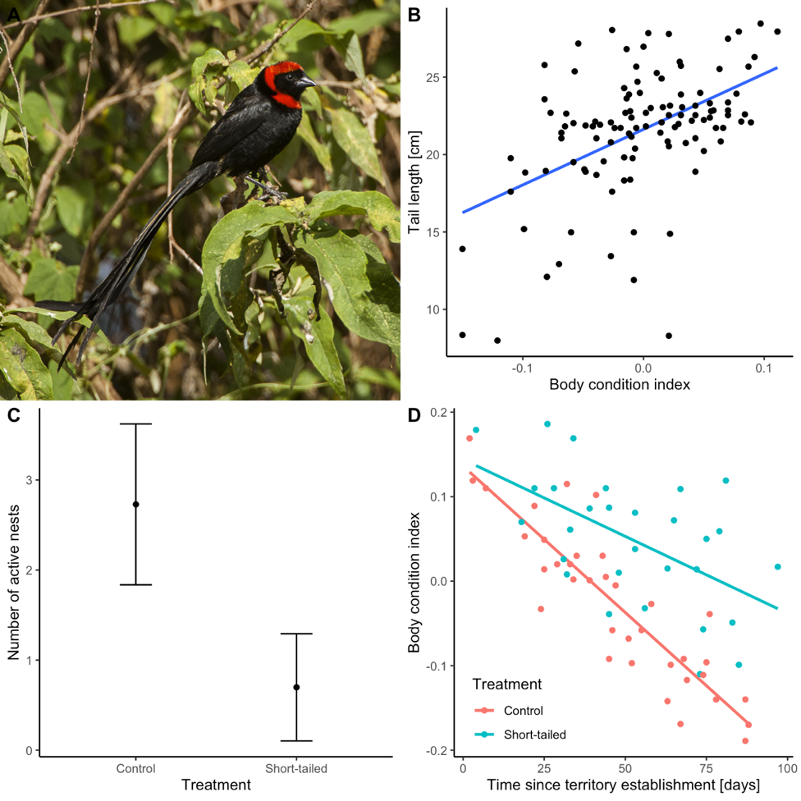
Why be choosy?
Indirect fitness benefits enhance the survivability or attractiveness of a female’s offspring
Male traits as indicators for “good genes”
Indicator traits must be costly and condition-dependent

Slide 21
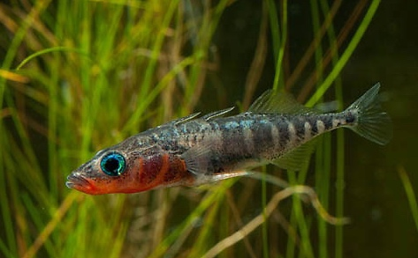
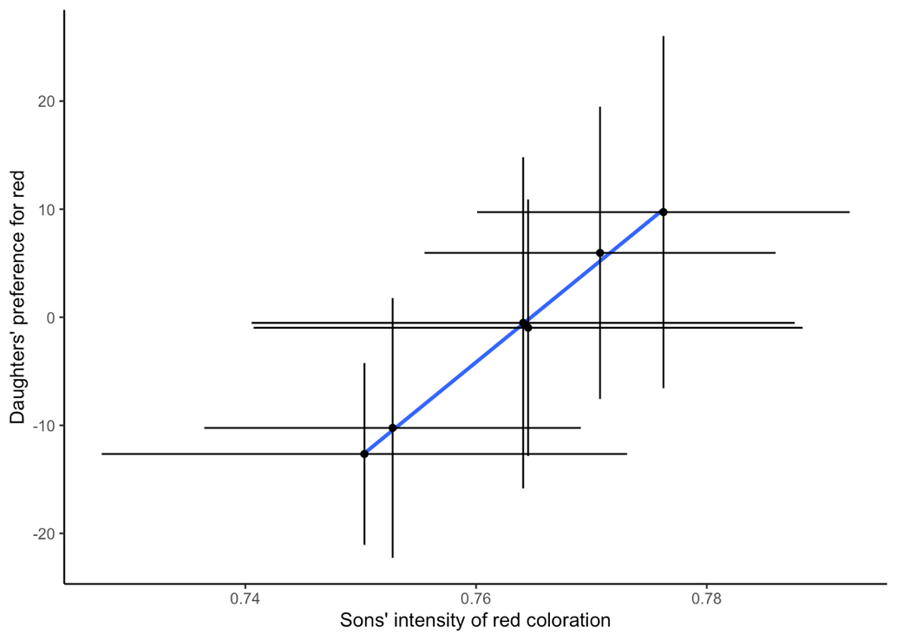
Why be choosy?
Indirect fitness benefits enhance the survivability or attractiveness of a female’s offspring
Arbitrary choice can lead to runaway selection of male traits and female preferences
If female preference and male trait are heritable, females with preference will have more attractive sons (sexy son hypothesis)
Selection on female preference and male traits form a self-perpetuating loop (Fisher’s runaway selection)

Slide 22
R exercise
Why should females exhibit preferences for certain males in lek-breeding species?
Solve section 3 in your R Notebook

Slide 23
Sexual selection and animal diversification
Natural and sexual selection may sometimes have conflicting effects
Sexual selection is still a strong driver of animal trait evolution

